Slide 1
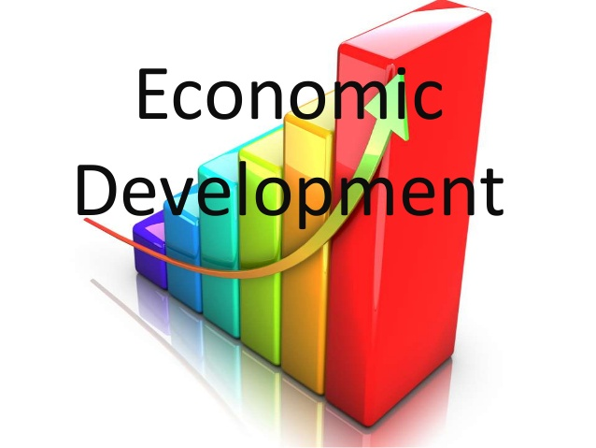
DEVELOPMENT

Slide 2
DIFFERENT GOALS
Different people have different Development
Goals
Apart from more income people need
EQUAL TREATMENT
FREEDOM
SECURITY
RESPECT OF OTHERS
RESENT DISCRIMINATION

Slide 3
Different person can have different goals what may be development for one can be destructive for others.
But what is of utmost importance is quality of life. People look at mix of goals.
Development should be such which is fair and just for all
IT SHOULD BENEFIT LARGE NUMBER OF PEOPLE.

Slide 4
HOW TO COMPARE DIFFERENT COUNTRIES/STATES.
For comparing countries their income is considered to be the main attribute.
Countries with higher income are more developed.
If we add the income of each individual it gives total income But different countries have different population
So , average income is calculated.

Slide 5
Average income is Total income/Total population.
It is also called per capita income.
According to World Bank Report countries have been classified on the basis of per capita income.- Rich countries, Low income countries and Low Middle development countries

Slide 6
Middle east countries are not included in rich countries , but they have high per capita income due to following reasons .
They have become rich due to sharp increase in oil prices.
Literacy rate do not match with developed countries
Wealth is accumulated in few hands only.

Slide 7
Apart from income there should be equitable distribution of income.
Countries may have high per capita income Literacy rate
Net attendance Ration may be low.
IMR ( Infant Mortality Rate)-Indicate the number of children that die before the age of 1 year as the proportion of 1000 children born

Slide 8
Literacy Rate-Measures the proportion of literate population in 7 and above age group.
Net attendance Ratio- Is the total number of children in age group 14-15 years attending school as total number in the same age group.
Money cannot buy-
Pollution free environment.
Unadulterated environment.

Slide 9
Money may not protect from infectious disease ,unless the entire community takes preventive steps.
States may have low per capita income but may be more developed because the Public distribution system functions well.

Slide 10
HUMAN DEVELOPMENT REPORT.
HDI is a statistical tool ( Published by UNDP) which is used to measure countries overall achievement in social and economic dimensions.
Education level
Health status.
Per capita Income
As per the 2018 report India ranks at 130 and a small country like Sri Lanka ranks at 76. Norway stands at No. 1 position.

Slide 11
Life expectancy at birth denotes average length of life of person at the time of birth.
Per capita Income is calculated in dollars to bring uniformity, so that dollars can buy the same amount of goods/ services in any country.

Slide 12
SUSTAINABLE DEVELOPMENT
The word sustainable means which is not short lived but can continue in future also. The concept of sustainability of development means finding out ways for continuous development without the risk of running out of resources or causing damage to the environment.

Slide 13
Steps for Sustainable Development .
More efficient use of natural resources.
Finding fresh sources of resources.
Coming up with innovative ideas and technology to use resources in a proper manner.

